Slide 1

Elementary Programming
COMSATS University Islamabad, Wah Campus

Slide 2

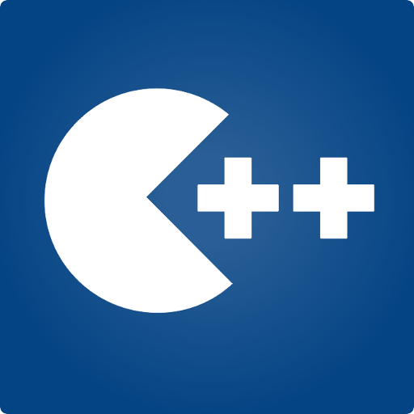
Programming Fundamentals
Taimur
MS(Data Science)
Lecturer (Computer Science),,
CUI Wah Campus

Slide 3
What is an Expression in C++?
An expression is a valid arrangement of variables, constants, and operators.
In C++, each expression can be evaluated to compute a value of a given type
In C++, an expression can be:
A variable or a constant (count, 100)
An operation (a + b, a * 2)
Function call (getRectangleArea(2, 4))

Slide 4
What is an Expression in C++?
An expression is a valid arrangement of variables, constants, and operators.
In C++, each expression can be evaluated to compute a value of a given type
In C++, an expression can be:
A variable or a constant (count, 100)
An operation (a + b, a * 2)
Function call (getRectangleArea(2, 4))

Slide 5
Assignment Operator
An operator to give (assign) a value to a variable.
Denote as ‘=‘
Only variable can be on the left side.
An expression is on the right side.
Variables keep their assigned values until changed by another
assignment statement or by reading in a new value.

Slide 6
Assignment Operator Syntax
Variable = Expression
First, expression on right is evaluated.
Then the resulting value is stored in the memory location of Variable on left.
NOTE: An automatic type coercion occurs after evaluation but before the value is stored if the types differ for Expression and Variable

Slide 7
Arithmetic Operators
Operators: +, -, * /
For floating numbers, the result as same as Math operations.
Note on integer division: the result is an integer. 7/2 is 3.
% (remainder or modulo) is the special operator just for integer. It yields an integer as the result. 7%2 is 1.
Both / and % can only be used for positive integers.
Precedence rule is similar to Math.

Slide 8
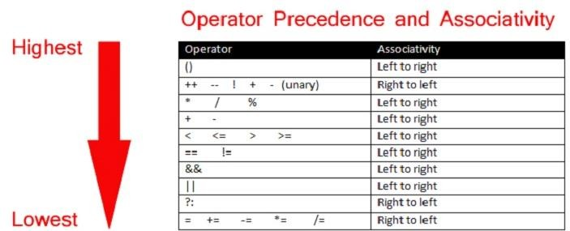
Operator Precedence
31

Slide 9
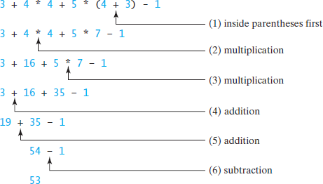
Evaluating an Expression and Operator Precedence
33

Slide 10

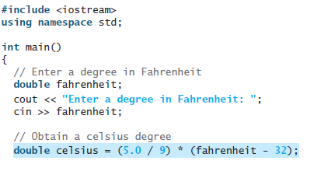
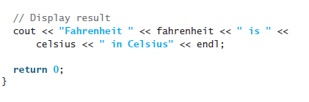
Task 01
Write a program that converts a Fahrenheit degree to Celsius using the formula
celsius = (5/9)( fahrenheit - 32).

Slide 11
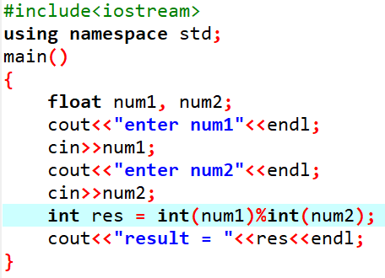
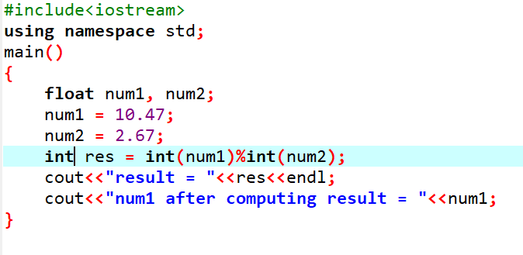
Task 01
Ask user to enter two floating point numbers and calculate their modulus.
Casting does not change the variable being cast

Slide 12
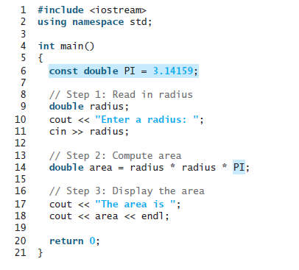

Named Constants
named constant is an identifier that represents a permanent value.
Syntax: const datatype CONSTANTNAME = value;

Slide 13
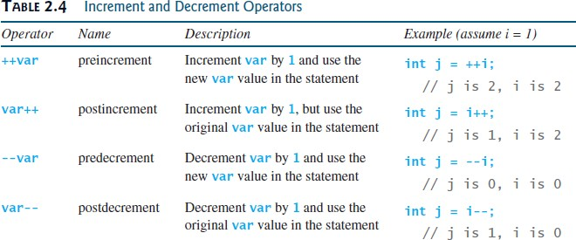
Increment and Decrement Operators
35

Slide 14
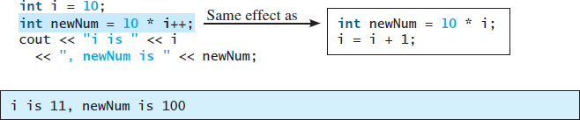
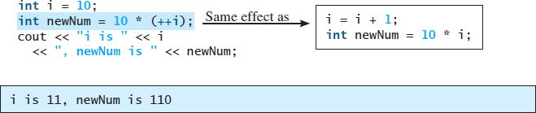
Increment and Decrement Operators
36

Slide 15
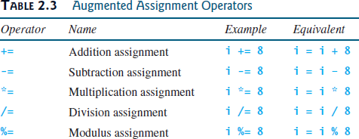
Augmented Assignment Operators
37

Slide 16
Escape Sequences
The backslash is called the escape character.
It tells the compiler that the next character is “escaping” it’s typical definition and is using its secondary definition.
Examples:
new line: \n
horizontal tab: \t
backslash: \\
double quote \”

Slide 17
Newline
cout<<“\n” and cout<<endl both are used to insert a blank line.
Advances the cursor to the start of the next line rather than to the next space.
Always end the output of all programs with this statement.

Slide 18
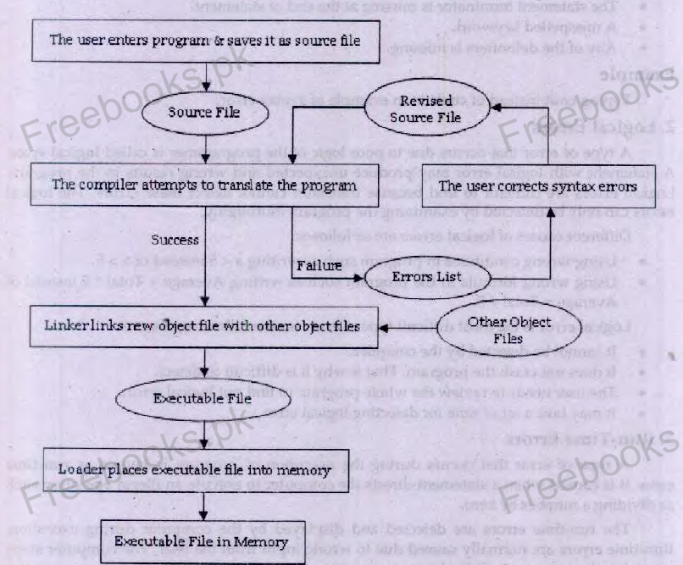
Executing a C++ Program

Slide 19
Types of Errors
Syntax (When an invalid statement is written i.e. Missing semicolon, misspelled word)
Logical (that occurs due to poor logic and cannot be detected by compiler)
Run-Time (Error occurs during execution time. When u open file not existing. Give wrong type of data.)

